Slide 1
Motivation
Lesson -7-

Slide 2
Consumer Motivation:
A motivated person is ready to act. He is influenced by his perception of the situation.
Why do people shop? How a consumer does assess his needs? What motivates him to choose a particular product over other? These questions are essence of marketing concepts, key for a given company to be successful, profitable and market leader. (i.e. exchange a product/service for the money), it is mostly to satisfy a need. But what could be of interest to marketer here is that, consumer needs are sometimes unfelt to consumer, but it represents a great deal of opportunity to the marketer.
As the marketing evolves, production orientation transforms into marketing orientation, which revolves around what the consumer wants and how to elicit the unfelt need of a consumer. Need can be innate (basic biological needs) or it can be acquired (learned through society and environment).

Slide 3
Consumer motivation is defined as driving force within individuals that leads to an action. In marketing concept that action would be acquiring a product or availing a service, that fulfills their needs and wants. This motivated behavior is always goal oriented, that what exactly is required to satisfy a particular need. This is one of the reasons why marketer doesn’t just focus on what a particular need is, but inclined to represent their product and service as the only means of solution for a particular consumer need. Needs are the core of the marketing concept. The study of Motivation refers to all the processes that drives in a person to perceive a need and pursue a definite course of action to fulfill that need.
What are Needs − Every individual has needs that are required to be fulfilled. Primary needs are food, clothing, shelter and secondary needs are society, culture etc.
What are Wants − Needs are the necessities, but wants are something more in addition to the needs. For example, food is a need and type of food is our want.
Needs and fulfillment are the basis of motivation. Change takes place due to both internal as well as external factors. Sometimes needs are satisfied and sometimes they are not due to individual’s personal, social, cultural or financial needs.

Slide 4
Motivation:
A need becomes a motive when it is aroused to a sufficient level of intensity. A motive is a need that is sufficiently pressing to drive the person to act.
There can be of types of needs:
1. Biogenic needs: They arise from physiological states of tension such as thirst, hunger
2. Psychogenic needs: They arise from psychological states of tension such as needs for recognition, esteem
In the words of William J Stanton, “A motive can be defined as a drive or an urge for which an individual seeks satisfaction. It becomes a buying motive when the individual seeks satisfaction through the purchase of something”. A motive is an inner urge (or need) that moves a person to take purchase action to satisfy two kinds of wants viz. core wants and secondary wants. Let us take two examples:
Examples of core and secondary want: Products | Core want | Secondary want
Glasses | Protection to eyes | It should look good
Shoes | Protection to feet | Elegance in style

Slide 5
Theory of Motivation:
Maslow’s Theory of Need Hierarchy
Based on the notion of a universal hierarchy of human needs Dr Abraham Maslow, a clinical psychologist formulated a widely accepted theory of human motivation. This identifies five basic levels of human need which rank in order of importance from lower level needs to higher level needs.
This theory signifies the importance of satisfying the lower level needs before higher level needs arise. According to this theory, dissatisfaction motivates the consumer.

Slide 6
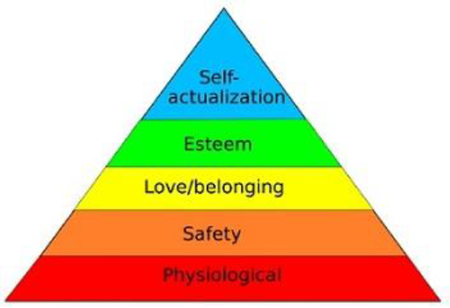

Slide 7
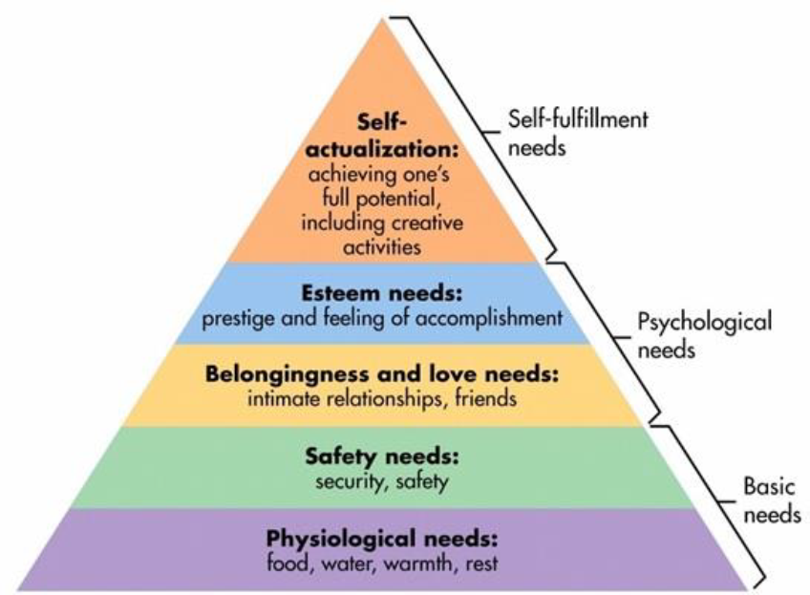

Slide 8
Following are the levels of human needs −
• At the bottom of the hierarchy Physiological Needs − Food, clothing, air, and shelter are the first level needs. They are known as the basic necessities or primary needs.
• The next level is Safety or Security Needs − Once the first level needs are satisfied, consumers move to the next level. Physical safety, security, stability and protection are the security needs.
• The third level of need is "Love and Belonging", which are psychological needs Social Needs − After the safety needs are satisfied, consumers expect friendship, belonging, attachment. They need to maintain themselves in a society and try to be accepted.
• Esteem Needs − Then comes esteem needs such as self-esteem, status, prestige. Individuals here in this stage want to rise above the general level as compared to others to achieve mental satisfaction.
• The fifth level is the "Cognitive" or Self-Actualization − This is the highest stage of the hierarchy. People here, try to excel in their field and improve their level of achievement. They are known as self-actualizers.

